Slide 1
hot hardness
thermal shock resistance
chemical stability
abrasion wear resistance
toughness
properties of cutting
tool materials

Slide 2
HSS
sintered tungsten carbide
cermets - TiC
ceramics
cBN
diamond
coated tools
coated HSS
coated carbides
hard coating – TiN, TiC, TiCN, Al₂O₃, TiAlN, cBN, diamond
soft coating – MoS₂, WS₂
hybrid coating – metal nitride + metal sulphide

Slide 3
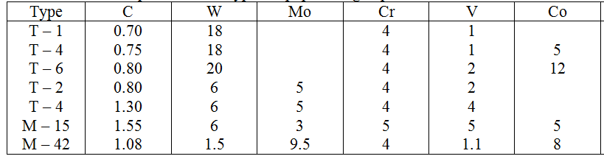
high speed steel

Slide 4
for machining cast iron, non-ferrous materials, Ti- and Ni- based superalloys
WC+Co
K grade – K01 to K40
for machining cast steels
M grade – M10 to M40
for machining steel
WC+Co+TiC+TaC+NbC
P grade – P01 to P40
micro-crystalline grade – grain size of WC less than 1 μm (typically 0.8 μm)

Slide 5
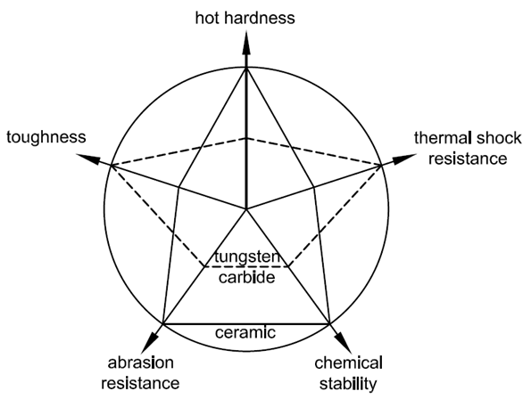
cermets – ceramic + metal
TiC, TiN, TiCN + Ni, Co, Ni-Co, Ni-Mo, Fe
ceramics
oxide (Al₂O₃) and nitride (Si₃N₄)ceramics
toughening is essential
partially stabilised zirconia,
silver
SiC whiskers toughened
SIALON (Si₃N₄ + Al₂O₃)

Slide 6
coated tools
coated HSS
coated carbides
hard coating – TiN, TiC, TiCN, Al₂O₃, TiAlN, cBN, diamond
soft coating – MoS₂, WS₂
hybrid coating – metal nitride + metal sulphide
lubricating coating – TiN, MoS₂, WS₂, DLC
technology
CVD
PVD
HF-CVD for diamond coating

